Slide 1


Slide 2
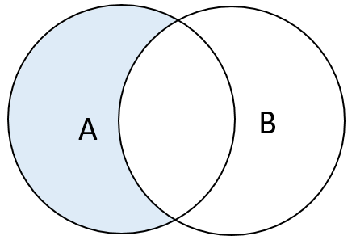
EXCEPT
EXCEPT operator is used to return all rows in the first SELECT statement that are not returned by the second SELECT statement.
SELECT expression1, expression2, ...
FROM tables
[WHERE conditions]
EXCEPT
SELECT expression1, expression2, ...
FROM tables
[WHERE conditions];
Syntax

Slide 3
EXCEPT
EXCEPT operator is used to return all rows in the first SELECT statement that are not returned by the second SELECT statement.
SELECT customer_id
FROM sales_2015
EXCEPT
SELECT customer_id
FROM customer_20_60
ORDER BY customer_id;
Example

